Slide 1
Unpacking Unconscious Bias
Live Session

Slide 2
Day 4:
Reinforcing Your Learning

Slide 3
Today’s Objectives
Reflect on the impacts and consequences of unconscious biases for all people involved.
Discuss various tips, tools and strategies to be able to better acknowledge and mitigate unconscious bias.

Slide 4
Agenda
Debrief the activity on facing your own biases;
Recognizing other people’s biases;
Group activity on assumptions;
Systemic barriers;
Moving from recognizing bias to mitigating bias;
Discuss the four-week learning journey;
Questions.

Slide 5
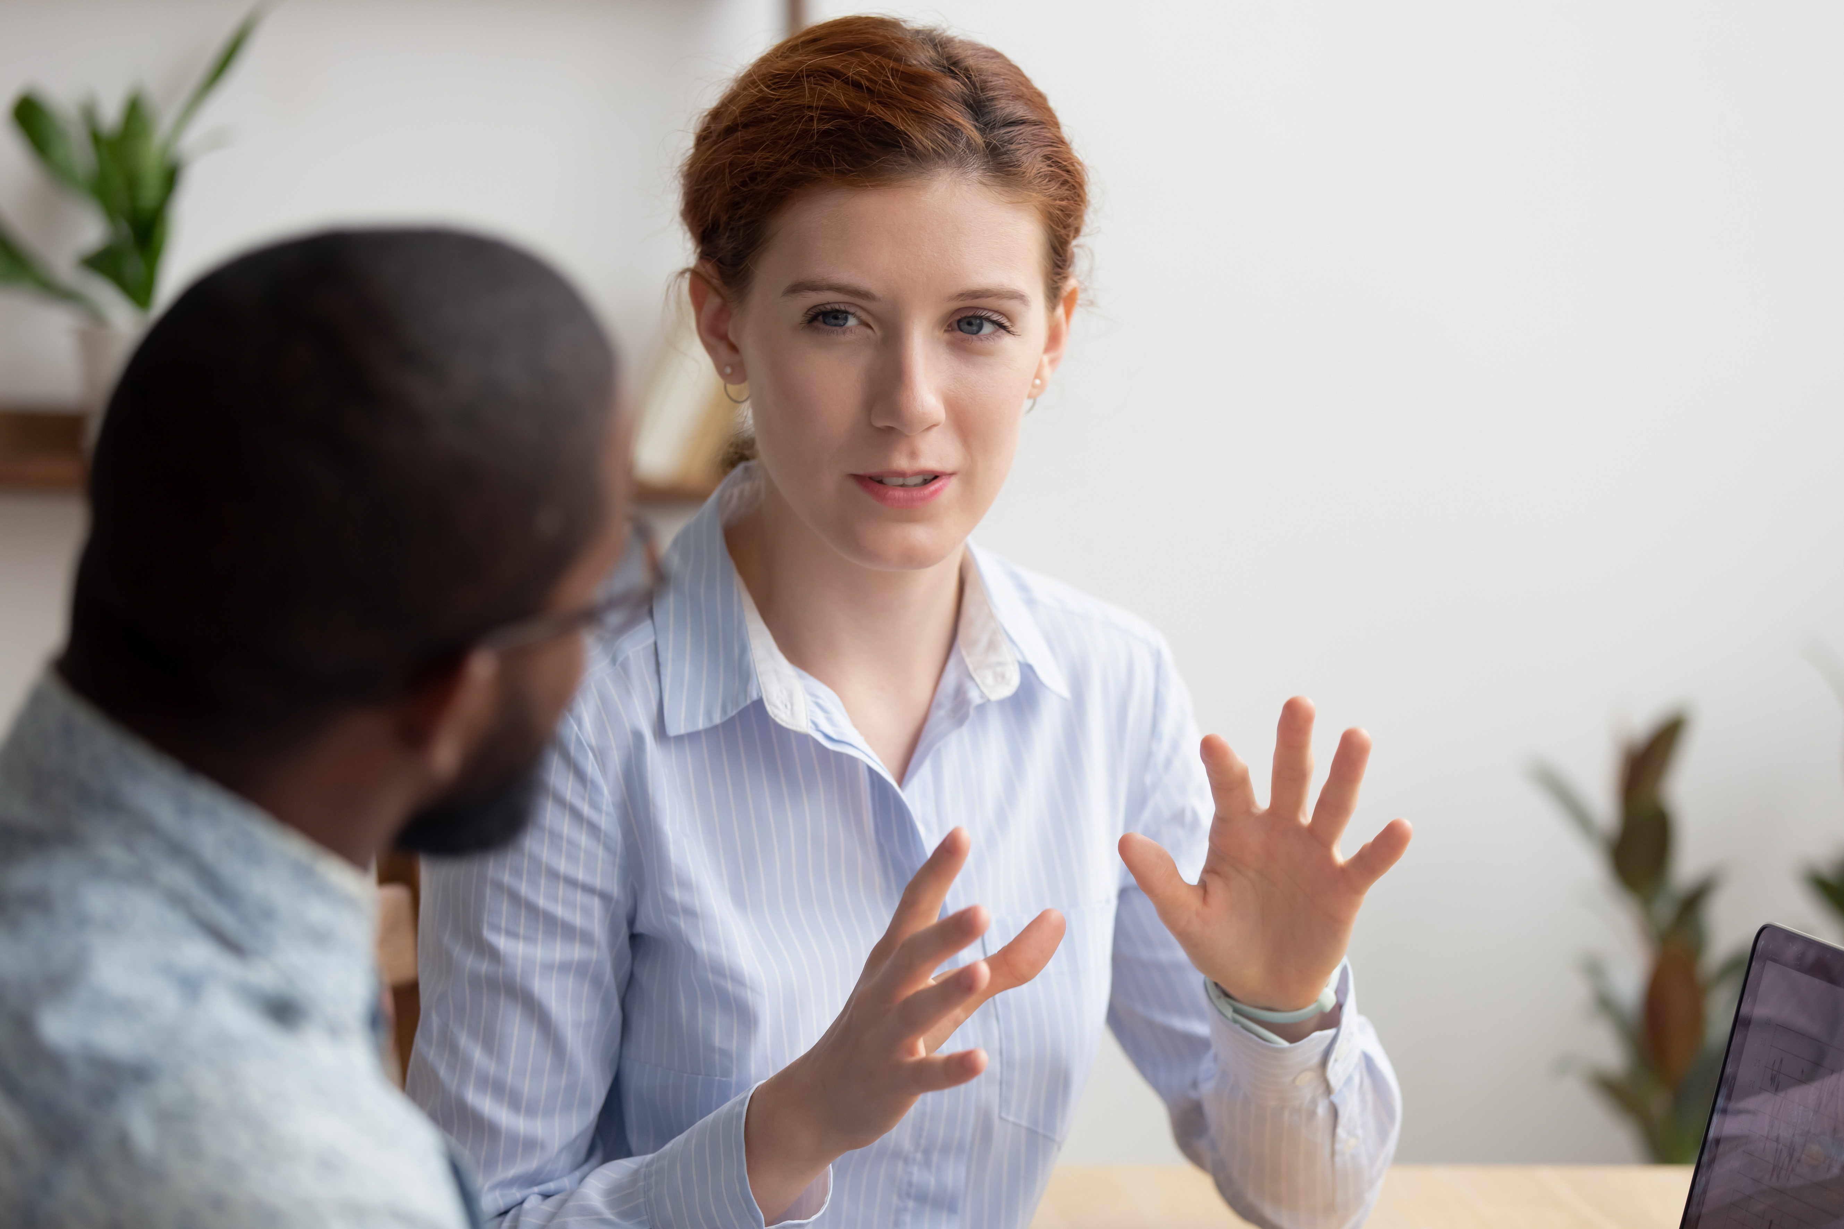
Debrief – Facing Your Own Biases!
What were your thoughts on the activity?
Did you learn anything new about yourself during the activity?
Did you learn anything new about biases during the activity?
Do you have any new ideas or insights about unconscious biases after completing the activity?

Slide 6
Recognizing Others’ Biases

Slide 7
Assumptions Activity
Small breakout room exercise

Slide 8
Assumptions Activity - Scenarios
What might be the experience of a trans person crossing an international border?
What might be the experience of a senior accessing public library services?
What might be the experience of a deaf person being rushed to the hospital to deliver a baby?
What might be the experience of a recent refugee to Canada during their Canadian citizenship ceremony?
What might be the experience of an Indigenous person applying for a position in the public service?

Slide 9
Assumptions Activity - Instructions
You will be sent to breakout rooms to work in small groups.
One of the scenarios will be posted in your breakout room and you will have 10 minutes to work together to discuss and brainstorm about the experience of the individual in your specific scenario.
Write down all of your thoughts and ideas using the annotation tools on the whiteboard.
Choose a member of your group to present the ideas on your whiteboard.
Debrief in plenary.

Slide 10

Break
Let’s take a quick break.
Please return in 10 minutes.
Please post a green checkmark (✓) when you are back from your break. Thank you!

Slide 11
Break
Please return in 9 minutes.
Please post a green checkmark (✓) when you are back from your break. Thank you!

Slide 12
Break
Please return in 8 minutes.
Please post a green checkmark (✓) when you are back from your break. Thank you!

Slide 13
Break
Please return in 7 minutes.
Please post a green checkmark (✓) when you are back from your break. Thank you!

Slide 14
Break
Please return in 6 minutes.
Please post a green checkmark (✓) when you are back from your break. Thank you!

Slide 15
Break
Please return in 5 minutes.
Please post a green checkmark (✓) when you are back from your break. Thank you!

Slide 16
Break
Please return in 4 minutes.
Please post a green checkmark (✓) when you are back from your break. Thank you!

Slide 17
Break
Please return in 3 minutes.
Please post a green checkmark (✓) when you are back from your break. Thank you!

Slide 18
Break
Please return in 2 minutes.
Please post a green checkmark (✓) when you are back from your break. Thank you!

Slide 19
Break
Please return in 1 minute.
Please post a green checkmark (✓) when you are back from your break. Thank you!

Slide 20
Systemic Barriers

Slide 21
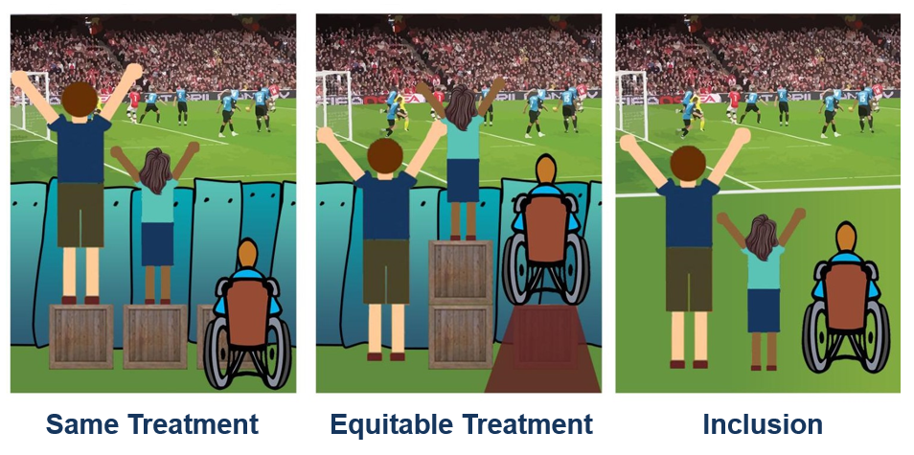
Systemic Barriers
Systemic barriers are defined as patterns of behaviours, policies and practices that may disadvantage access or fairness for people, or a group of people.
It happens when a law, policy, directive, guiding principle or corporate culture creates or perpetuates barriers preventing certain people or groups of people from accessing and benefiting the same way as others.
Source: www.canadianequality.ca
Addressing systemic barriers can help reduce
micro-aggressions and micro-inequities in the workplace.

Slide 22

Mitigating Bias
Moving from recognizing bias to mitigating bias.

Slide 23
Challenges of Mitigating Biases
What are, in your opinion, things that limit us or challenge us when we try to mitigate our bias?

Slide 24
Inclusive Practices
Inclusive wording: terminology during verbal communications and written correspondences;
Inclusive meetings: internal and external meetings with colleagues, stakeholders, clients, or partners;
Inclusive events: in planning and implementation;
Inclusive hiring processes and tools: in recruitment and promotions;
Inclusive coaching: constructive feedback, performance evaluation, mentorship;
Inclusive project/program/policy management: development, consultations, decision-making.

Slide 25

Remember
We all have biases!
Biases are irrational thoughts and attitudes based on assumptions and stereotypes.
While it is normal to have biases, it is our individual and collective responsibility to be more aware, to recognize them and to try to avoid acting on them in order to foster positive, respectful and inclusive workplaces.
Diversity + managing unconscious biases = building a more respectful and inclusive workplace.

Slide 26

Learning Journey
Reflect on your personal learning journey over the past four sessions.

Slide 27
The beauty of life is to be outside the box, so that the box doesn’t exist…to limit a human being to one mode of expression is really a crime.
- Herbie Hancock

Slide 28
Questions

Slide 29
Thank you for your participation!

